Slide 1
Cleaning Quality & Utilization Performance – UAE
Performance Report | 2-Month Period
Metrics Measured: Average Rating & Utilization

Slide 2
Performance Overview
Overall Performance Summary:
• Overall Average Rating: 4.64
• Average Daily Duration: 2.42 hrs
• Total Cleaners: 246
• Total Companies: 9
• Total Bookings: 27,003
The analysis focuses on two key metrics — service quality (rating) and cleaner utilization.

Slide 3
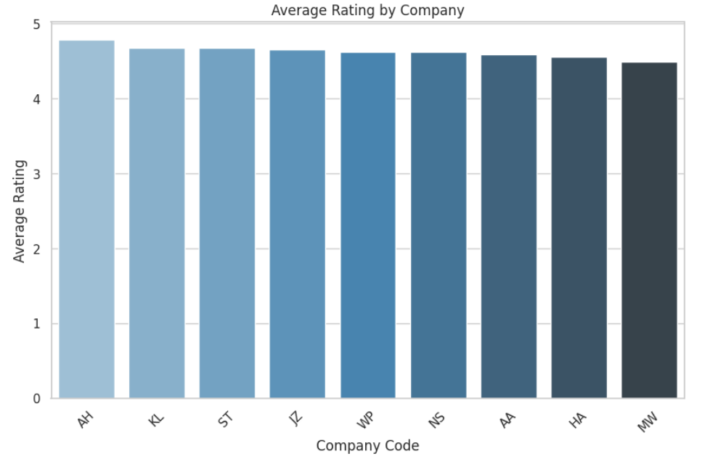
Average Rating by Company

Slide 4
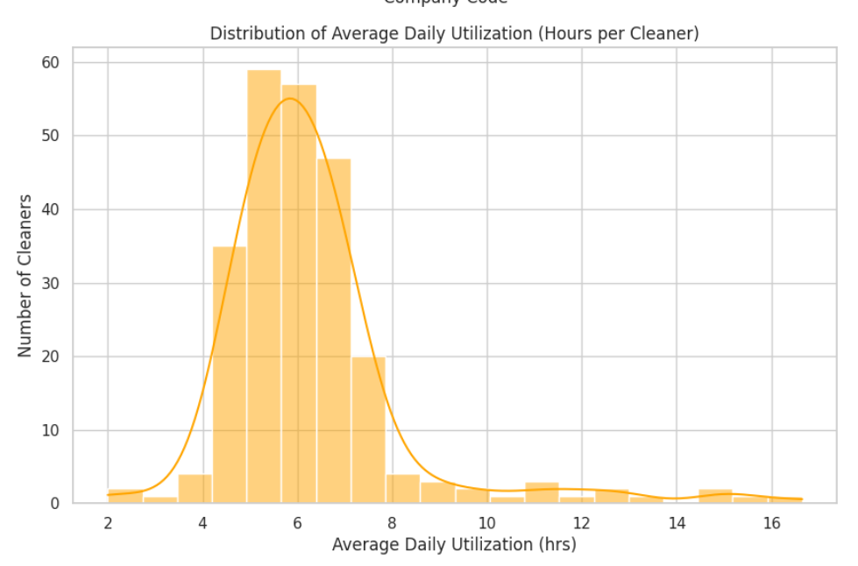
Distribution of Average Daily Utilization

Slide 5
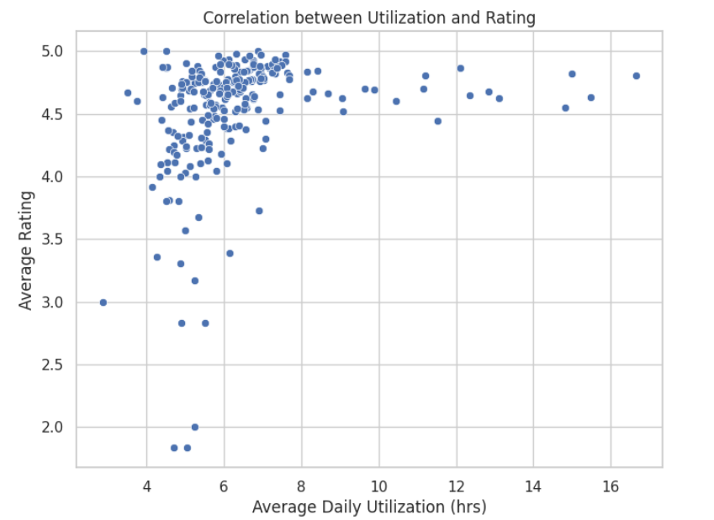
Correlation Between Utilization and Rating

Slide 6
Key Insights & Recommendations
Key Insights:
• Companies AH, KL, and ST show highest customer satisfaction (>4.6).
• Average cleaner utilization ~5 hrs/day; potential to optimize schedules.
• Positive correlation between utilization and rating — efficient cleaners perform better.
Recommendations:
️⃣ Retrain cleaners with <4.0 rating.
️⃣ Assign low-utilized cleaners to peak-hour slots (10:00–22:00).
️⃣ Prioritize repeat clients for top-rated cleaners.
️⃣ Monitor performance weekly via dashboards.
️⃣ Reward top 10% performers (Rating + Utilization).

